Slide 1
Microsoft Fabric will solve our analytical challenges, but how do we organize it?!

Slide 2

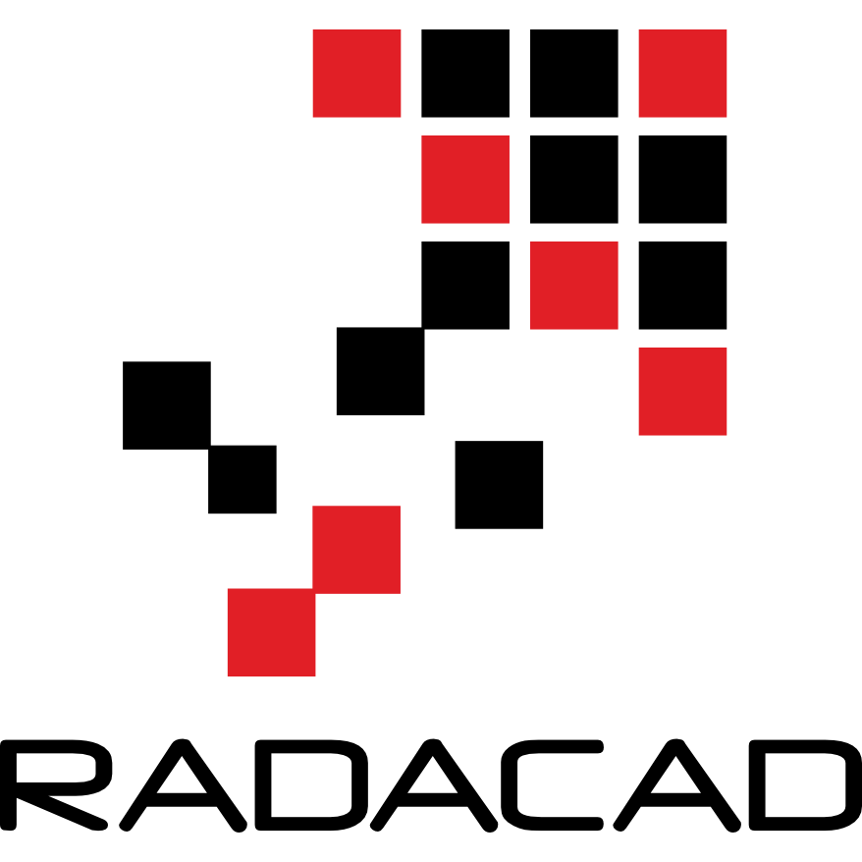
Special thanks to Fabric and Power BI Team at
This Summit presented to you by

Slide 3
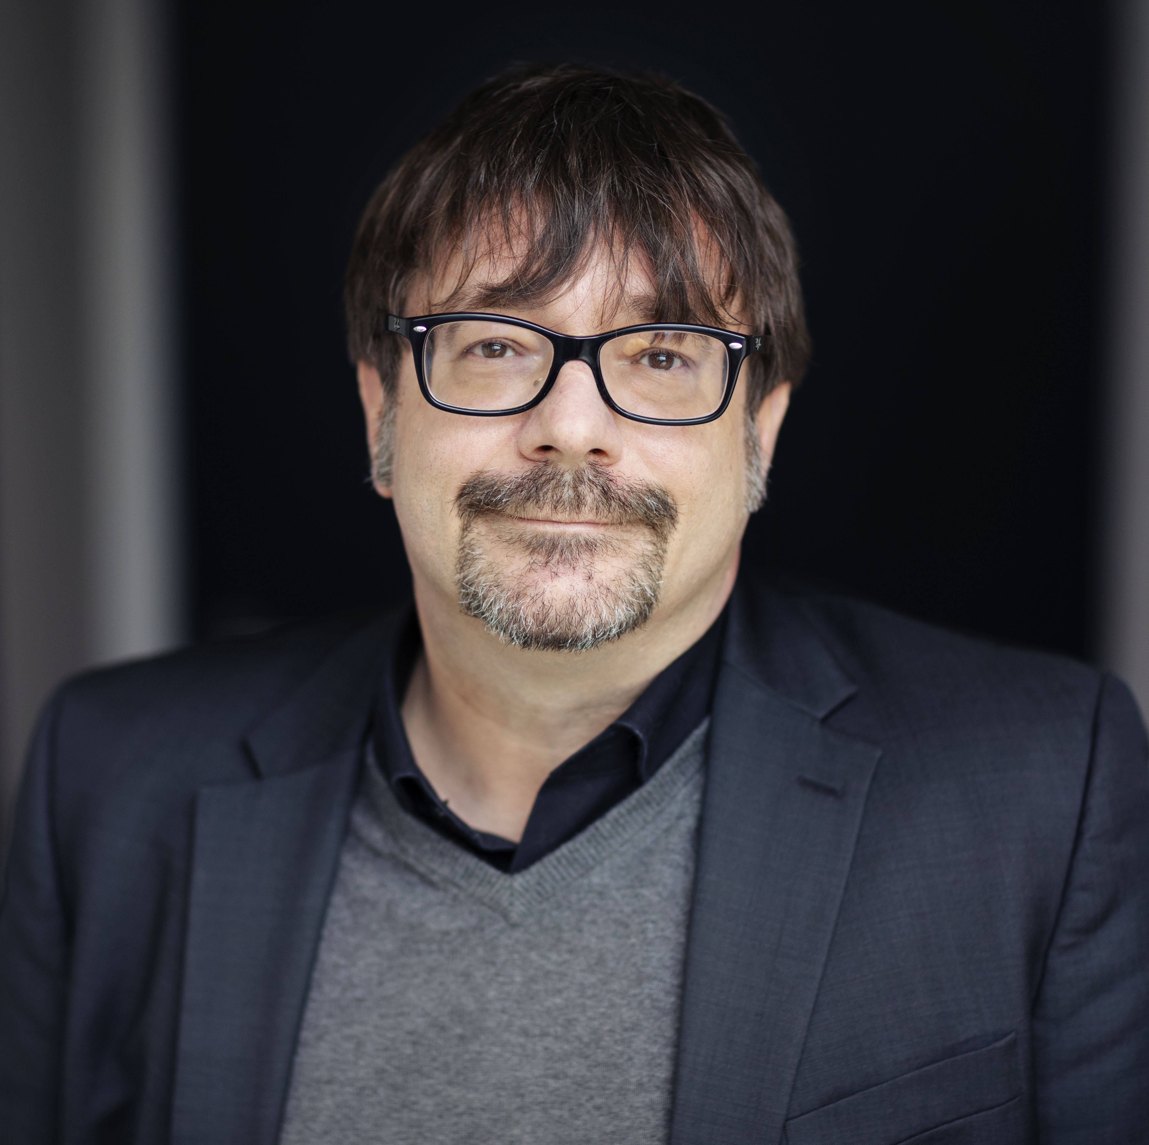
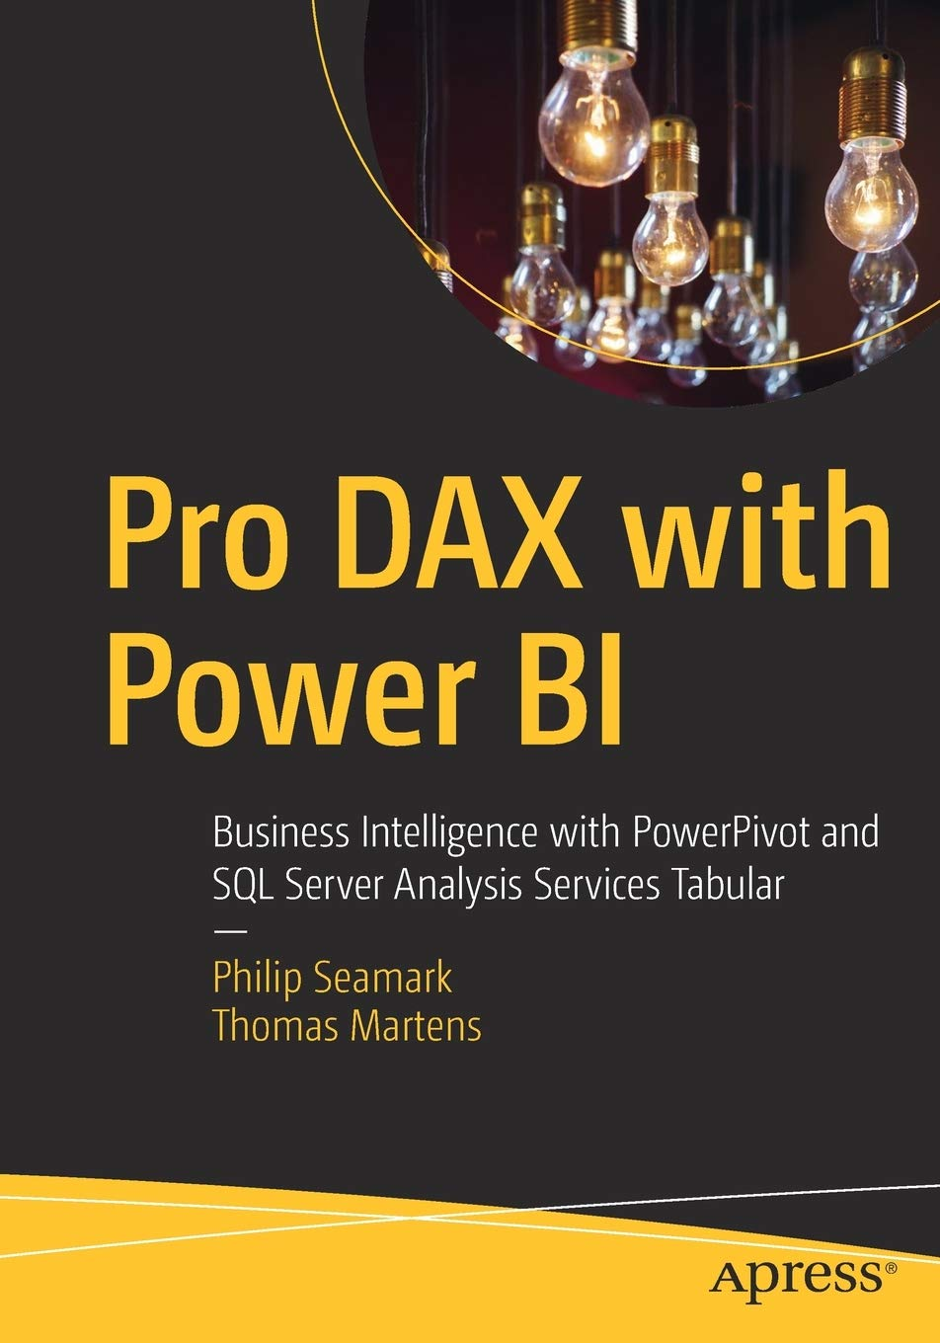
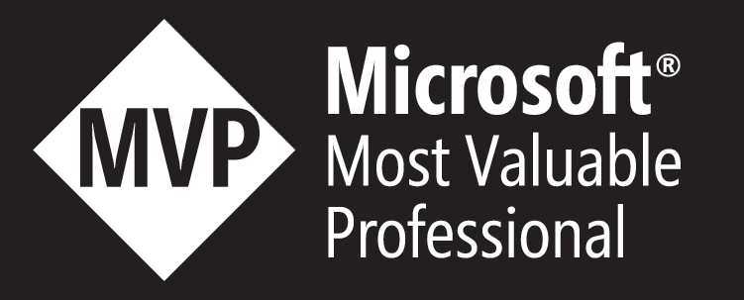
25+ years of experience designing analytical solutions using the MSFT data platform
Tom Martens
Solution Architect @ Munich Re
/tommartens68
@tommartens68

Slide 4
Agenda
How we (should) work today (maybe a glimpse to the future for some of us)
Our beloved workspace
Deployment pipelines and the thin report
The Fabric workspace and all the new capabilities
All the new items
New Colleagues, the team will grow
The landscape of a Microsoft Fabric “solution”

Slide 5
How we (should) work

Slide 6
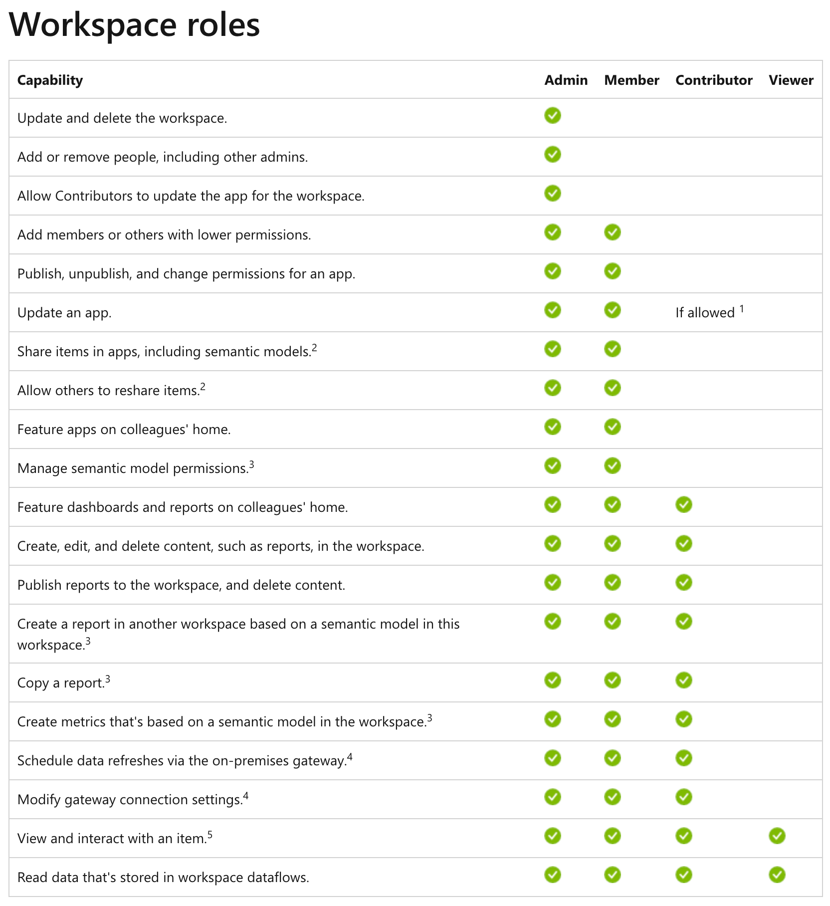






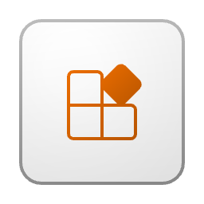


How we work today – our beloved workspace

Slide 7
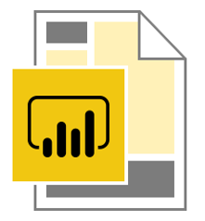
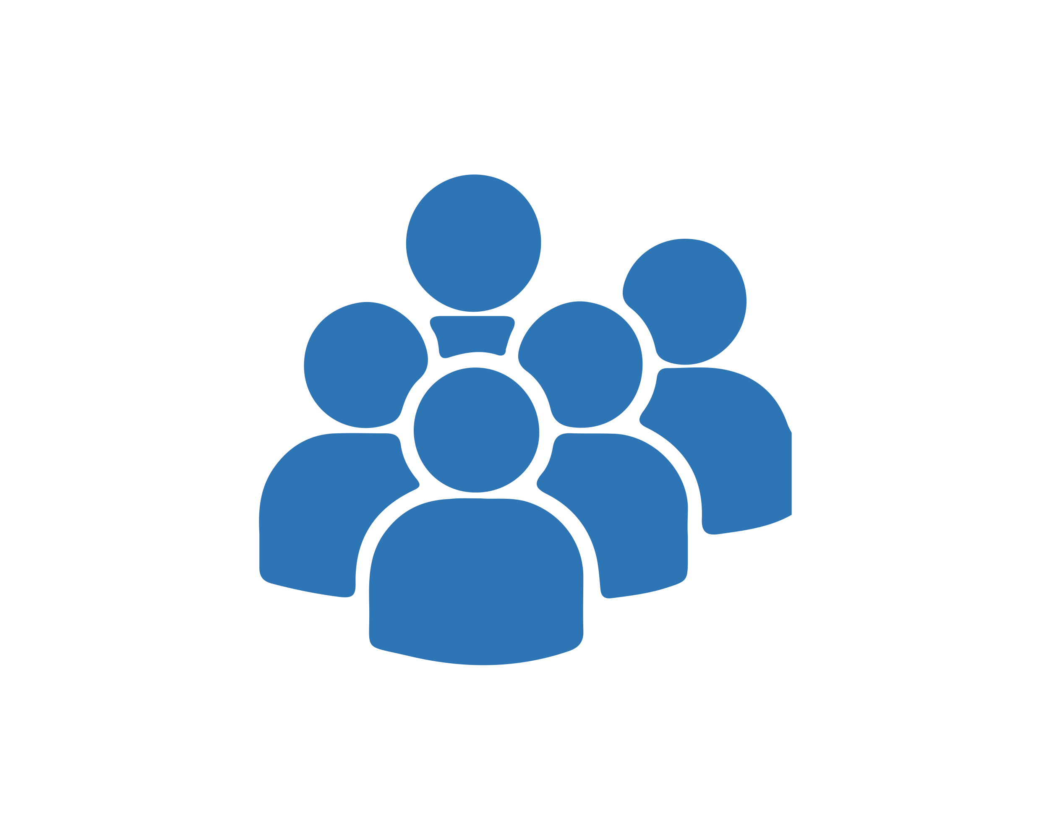






How we work today – thin reports
Separating the data (the semantic model) from the content (our data visualizations):
Data workspace
Content workspace(s)
Create 1 to n content workspaces
This allows us to reuse the existing semantic models. This is not the same as multiple audiences per app 😉
Content creators only require the contributor role assigned in the content workspace
Content creators are connecting to the Power BI semantic model
Content creators are not members of the data workspace
Content creators need Build Permission on the semantic model
Row Level Security will be honored if data and content workspaces are separated
Create a data workspace and consider a workspace being an Analysis Services Tabular instance!
Using multiple Power BI files, connected to a Power BI dataset instead of the data sources: thin reports

Slide 8
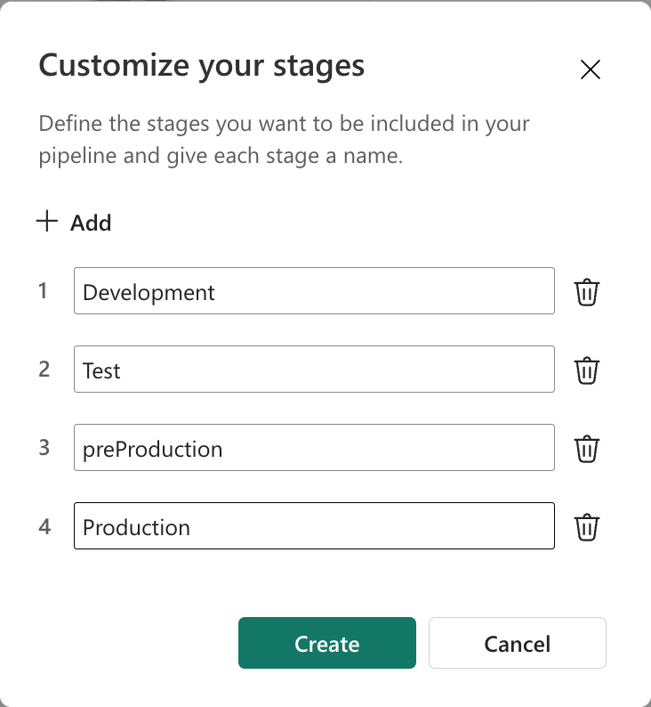

How we work today – deployment (before Fabric, not considering synching between a Fabric workspace and Azure DevOps repo)
PROD stage
Configure your Power BI Deployment pipeline (from 2 to 10 deployment stages)
prePROD stage
Use the
Power BI deployment features to push items to the stages additional
Use Azure deployment pipelines leveraging the Power BI deployment APIs if you need more control (items are not stored in AzDevOps)
TEST stage
DEV stage
Publish pbix to DEV workspace(s)
We use 8 workspaces for a Power BI solution, hopefully there is more to it than a meaningless pie chart

Slide 9
The Fabric workspace

Slide 10
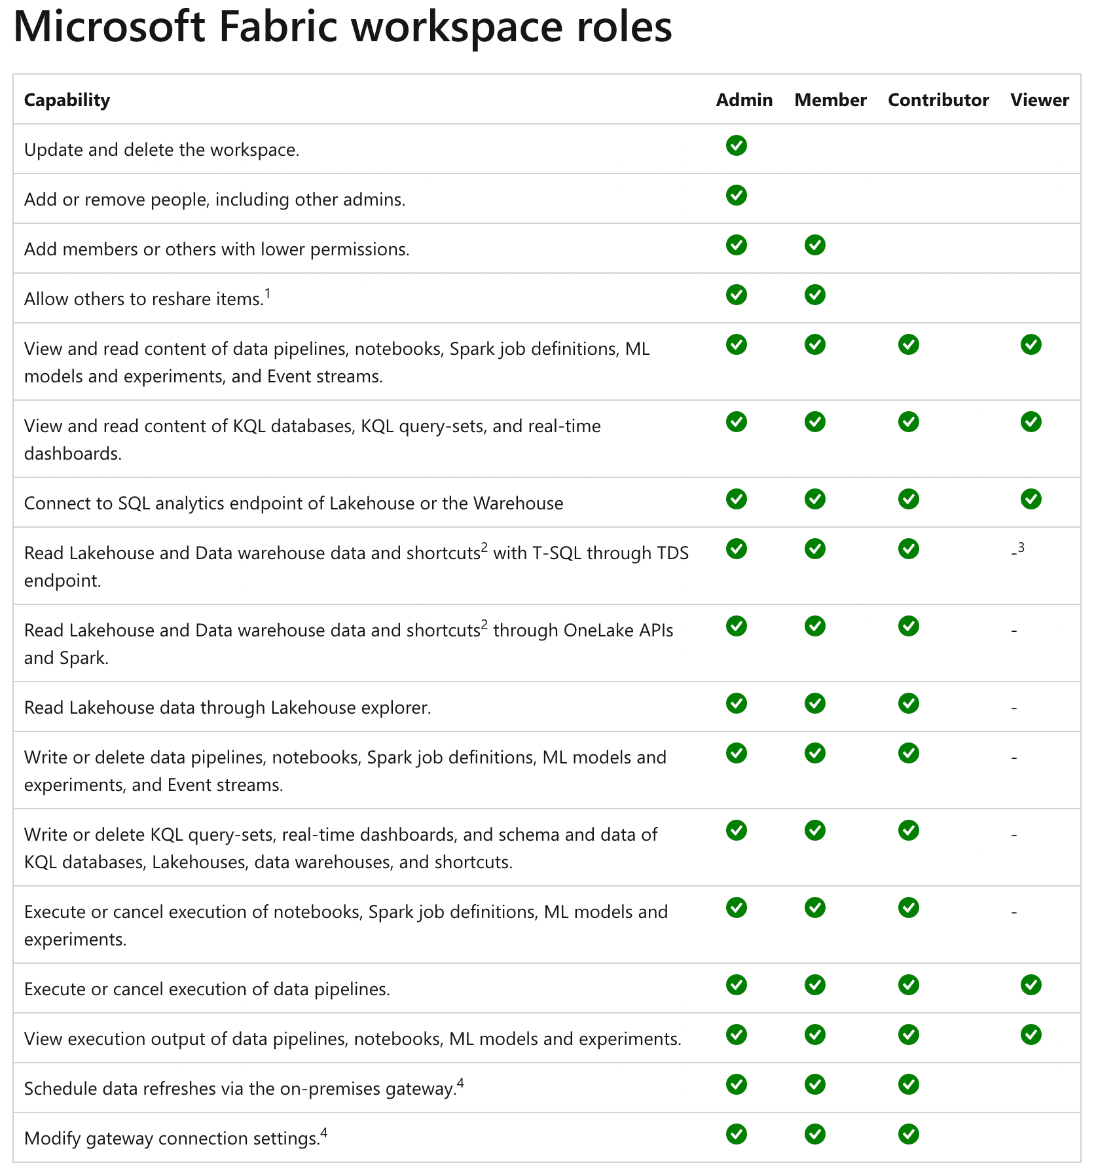
The Fabric workspace – all the new items

Slide 11

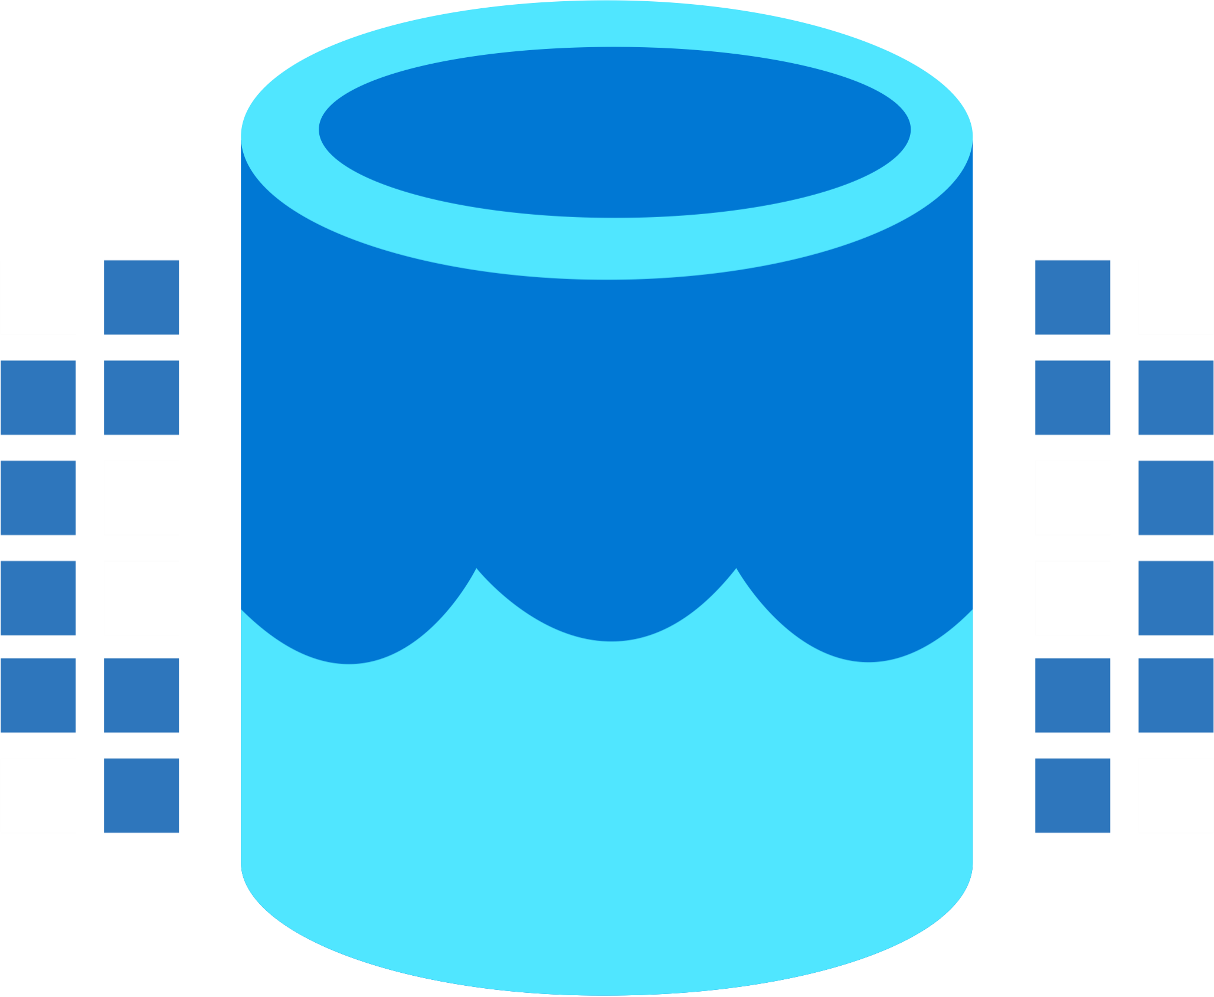

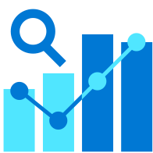

How we work tomorrow
Data Integration
Data Lake
Spark Engines
Data Lakehouse/
Warehouse
Real Time Analytics
Data
Science
Business
Intelligence
Governance
End-to-end analytics data fabric - From the data lake to the business user

Slide 12
How we work tomorrow
Data Integration
Data Lake
Spark Engines
Data Lakehouse/
Warehouse
Real Time Analytics
Data
Science
Business
Intelligence
Governance
End-to-end analytics data fabric - From the data lake to the business user

Slide 13
How we work tomorrow (the team is growing)
Data Integration
Data Lake
Spark Engines
Data Lakehouse/
Warehouse
Real Time Analytics
Data
Science
Business
Intelligence
Governance
End-to-end analytics data fabric - From the data lake to the business user

Slide 14
The landscape of a Microsoft Fabric solution! (My thinking)

Slide 15





The landscape of a Microsoft Fabric solution! (My thinking)
Licensing Fabric Capacity
I imagine a capacity (no matter if it’s a shared capacity (Pro Licensing), a Premium Per User capacity, a Premium Capacity, or a Fabric capacity as a means, that adds capabilities to a workspace.
Fabric capabilities require a Premium or a Fabric capacity.
Fabric workspace

Slide 16
The landscape of a Microsoft Fabric solution! (My thinking)
The foundation of every Microsoft Fabric based solution:

Slide 17



The landscape of a Microsoft Fabric solution! (My thinking)
The Storage called OneLake that is based on ADLS Gen2
The foundation of every Microsoft Fabric based solution
The storage is based on Azure Data Lake Storage Gen2 architecture!

Slide 18
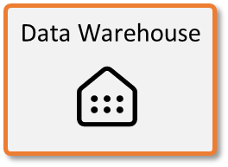
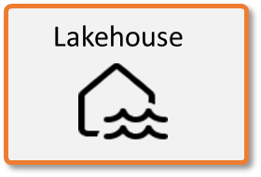



The landscape of a Microsoft Fabric solution! (My thinking)
The Storage called OneLake that is based on ADLS Gen2
The foundation of every Microsoft Fabric based solution
The storage is based on Azure Data Lake Storage Gen2 architecture!
Microsoft Fabric Compute engines are able to read delta tables natively!
Data
Warehousing
Data
Engineering
Data Integration
Data
Science
Real
Time
Analytics
Business Intelligence
KQL Database
Semantic Model
Unified Management and Governance
OneLake
Workspace A
Workspace B

Slide 19
The landscape of a Microsoft Fabric solution! (My thinking)
The Storage called OneLake that is based on ADLS Gen2
The foundation of every Microsoft Fabric based solution
The storage is based on Azure Data Lake Storage Gen2 architecture!
Microsoft Fabric Compute engines are able to read delta tables!
Separation of storage and compute
Data
Warehousing
Data
Engineering
Data Integration
Data
Science
Real
Time
Analytics
Business Intelligence
KQL Database
Semantic Model
Unified Management and Governance
OneLake
Workspace A
Workspace B

Slide 20
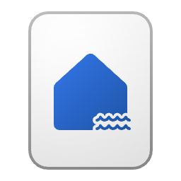

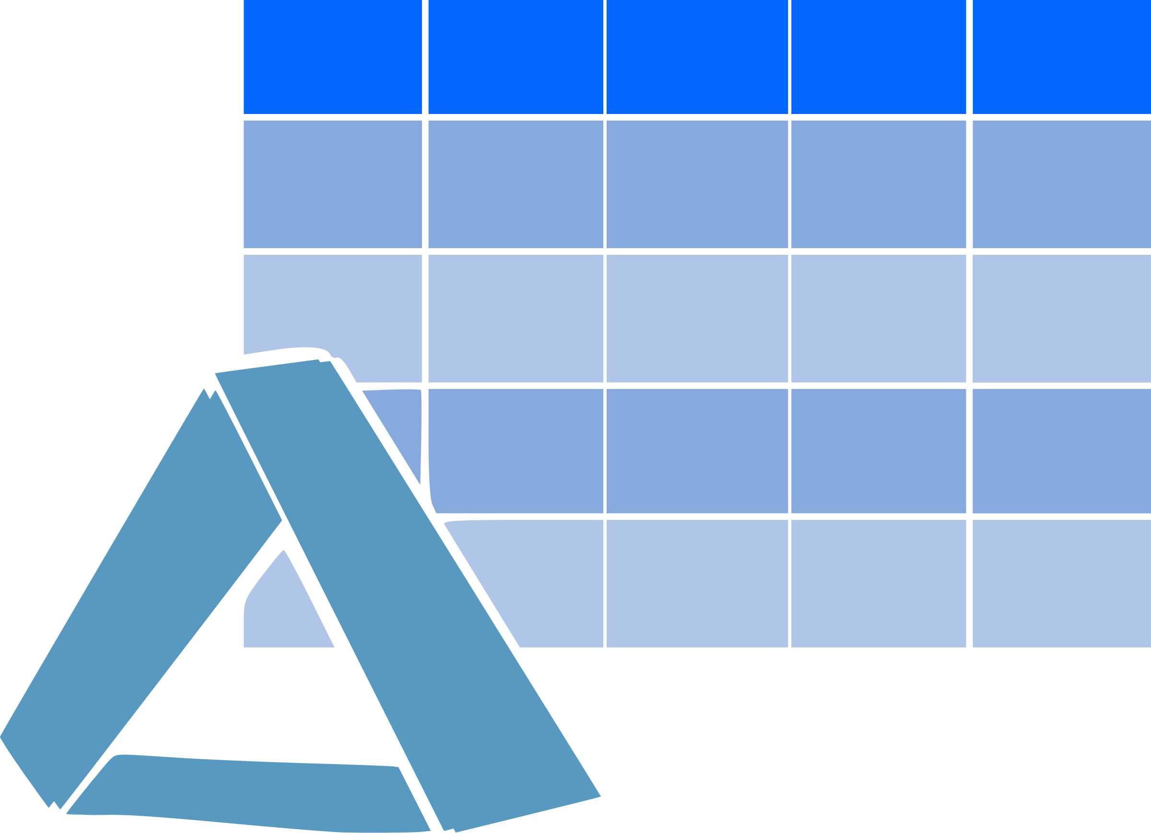
The landscape of a Microsoft Fabric solution! (My thinking)
The Lakehouse – Medallion architecture
We can create a Lakehouse leveraging the Medallion Architecture
Placing each metal in a dedicated workspace
Bronze (Landing Zone)
Silver
Gold (Business level aggregates)
Data Integration

Slide 21
The landscape of a Microsoft Fabric solution! (My thinking)
The Lakehouse – Medallion architecture
We can create a Lakehouse leveraging the Medallion Architecture
Placing each metal in a dedicated workspace
Bronze (Landing Zone)
Silver
Gold (Business level aggregates)
Data Integration
Different stages of the Medallion architecture may be placed on different capacities

Slide 22
The landscape of a Microsoft Fabric solution! (My thinking)
The Lakehouse – Medallion architecture
Using dedicated compute power (a capacity) for Data Science workloads because these workloads might run less frequently, require extra computing power, or …
Bronze (Landing Zone)
Silver
Gold (Business level aggregates)
Data
Science

Slide 23
The landscape of a Microsoft Fabric solution! (My thinking)
Using dedicated compute power (a capacity) for Data Science workloads because these workloads might run less frequently, require extra computing power, or are shared between multiple Fabric solutions. Be aware of data residency requirements!

Slide 24
The landscape of a Microsoft Fabric solution! (My thinking)
Multiple Power BI solutions with a semantic model in Direct Lake connection mode are reading delta tables from the Gold layer.
All semantic models might share the same capacity

Slide 25
The landscape of a Microsoft Fabric solution! (My thinking)
The only reason why the Data Warehouse workload and the real-time analytics workload did not appear on the previous slides is space. But maybe a Lakehouse is all you need!
Next, a single Fabric capacity can be sufficient, depending on the amount of data you want to process.
Fabric, will help us answering our most challenging questions, but our world has become more complex.
We have to think! (Of course, this is not that new ☺)

Slide 26
Resources
Microsoft Fabric adoption: https://learn.microsoft.com/en-us/power-bi/guidance/fabric-adoption-roadmap
Power BI workspace roles: https://learn.microsoft.com/en-us/power-bi/collaborate-share/service-roles-new-workspaces
Fabric workspace roles: https://learn.microsoft.com/en-us/fabric/get-started/roles-workspaces
Fabric Icons: https://learn.microsoft.com/en-us/fabric/get-started/icons

Slide 27
Thank you
Connect to me at:
Stay online for my live Q&A sessions
/tommartens68
@tommartens68

